Slide 1
Maximize lab productivity with Empower software

Slide 2
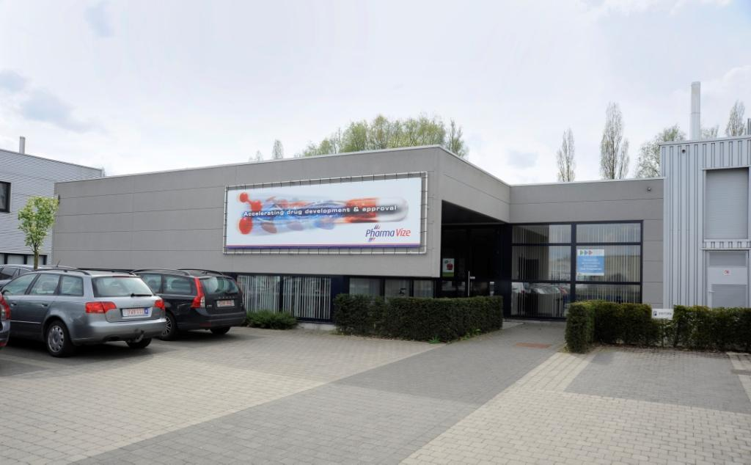
Company Profile
Established in 1995
Operate from Mariakerke (Ghent), Belgium
Providing CMC services to the pharmaceutical industry
Expansion of activities:
1995: Regulatory & quality services
2000: Contract research
2005: GMP manufacturing / stability studies
Since 2006: GMP license for manufacturing non-sterile clinical trial materials

Slide 3
Integrated CMC Services
Pharmavize Services
Pharmavize CDMO
(Contract development & manufacturing)
CMC Regulatory Writing
CMC Technical Writing
GMP Quality Management Support
Formulation Development
Analytical Development
Stability Studies
GMP Small-scale Manufacturing
Clinical Supply Labelling
EU Import and Release of Clinical Supplies

Slide 4
Analytical Development Services
HPLC/UPLC/GC method development and optimization
Dissolution method development
API characterization
Identification of degradant products and impurities (LC/MS)
Method validation and transfer activities
Specification setting
Quality control and release testing

Slide 5
Stability Studies
ICH stability studies
Accelerated studies (ASAP)
Photostability studies
In-use stability studies
Ongoing stability studies

Slide 6
Current lab situation
8 Alliances (equipped with PDA and PDA/RI)
2 UPLC-H (equipped with PDA and PDA/QDa)
1 UPLC (equipped with PDA)
Empower 3.2
Enterprise environment: server – client – laces (nodes)
Laces: useful as data buffer

Slide 7
Empower as CDMS
Instrument control
Data acquisition
Data processing
Data reporting
Archiving
Compliance

Slide 8
1. CDMS – instrument control
Wide range of equipments and detectors
Multi-vendor control
Less training time
General SOP concerning Empower use
Tree structure for each project

Slide 9
2. CDMS – data acquisition
Instrument method ID: unique – usable for equal HPLCs
Injection ID – sample set ID
Acquity eCord:
- in configuration manager
- column: care & use and CoA
- sample set information: max pressure – max temperature
- injection information: injection count

Slide 10
3. CDMS – data processing
Custom fields
System Suitability option
Processing method (wizard) – calculate suitability results
Pharmacopoeia: USP – EP – JP
Table properties: selection of SST parameters
Common used: s/n – resolution – symmetry factor

Slide 11
3. CDMS – data processing

Slide 12
3. CDMS – data processing
Custom fields
System Suitability option
Processing method (wizard) – calculate suitability results
Pharmacopoeia: USP – EP – JP
Table properties: selection of SST parameters
Common used: s/n – resolution – symmetry factor
Spectral peak purity: angle – threshold – peak purity plot

Slide 13
3. CDMS – data processing

Slide 14
3. CDMS – data processing

Slide 15
3. CDMS – data processing

Slide 16
4. CDMS – data reporting
Result ID
Different report types: full scale – detail – overlay – UV – SST report
Customized: logo – reported by user – project name
Chromatographic results – comparison within and across projects – see overlay

Slide 17
4. CDMS – data reporting

Slide 18
4. CDMS – data reporting

Slide 19
4. CDMS – data reporting

Slide 20
5. CDMS - archiving
Project archiving: short backup time and less data volume
Audit readiness:
- project restoring
- easy accessible
- easy data search
- traceability

Slide 21
6. CDMS - Compliance
SQT (instruments and software) – validation Empower nodes – validation Empower for intended use
Software security
User access management: user groups and types (privileges)
Audit trail
Traceability by unique ID numbers within project
→ Data integrity !

Slide 22
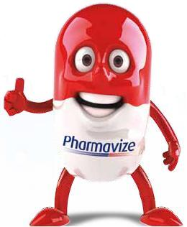
Thank you for your attention
Sandra Hillaert
Pharmavize NV
Kleimoer 4
9030 Mariakerke
Belgium
www.pharmavize.com

